Slide 1

Cloud Computing for Data Analysis Final Project University of North Carolina at Charlotte
Credit Score Classification
Group- 5
Gaurav Avula
Naga Nikhil Bijjala
Harshini Karnati
Rohan Katari
Naga Srivatsav Machiraju
Date: 12/11/2023
Notes:
Students: Use this template to effectively present and communicate your group project to a broader audience. Your students can also use this presentation as a portfolio of their work to demonstrate their cloud skills.
The presentation structure is listed below. The total time may vary depending on the activities your team wants to include. For example, your team may to provide a high-level walkthrough of your work solutions versus a deep-dive into why or how your team chose certain services and the steps of building the architectures.
Suggested timing for a 10-minute presentation:
Introduction – 1 minute
Business scenario overview – 1 minute
Solution overview – 2 minutes
Architecture diagram of the solution – 2 minutes
Demo – 3 minutes
Lessons learned – 1 minute

Slide 2
Business scenario overview
The project addresses the problem of assessing individuals' creditworthiness accurately, helping financial institutions make informed lending decisions.
Determining the credit worthiness of a individual using advanced machine learning algorithms.
By developing a machine learning model for credit score classification, it aims to provide an opportunity to improve risk assessment, reduce defaults, and expand access to credit for qualified applicants.
Notes:
Define the problem or opportunity that you are addressing. Include pictures, figures, and statistics to help the audience better conceptualize the problem or opportunity.
Specify who your users or customers are and why they care..
List any specific business requirements that you are addressing.
Note:
A good overview succinctly defines the problem and opportunity statement. For example: “Customers with media files, such as retail companies, need an easy and cost-effective way to analyze photos and videos of their inventory.”
A below standard overview is too verbose, technical, or not specific. For example: “The most common media files are .jpg and .mp4. Companies have media files of their inventory.”

Slide 3
Solution overview
A high-level description
The scope of this project involves designing and implementing a machine learning model for credit score classification.
It encompasses data collection, preprocessing, and feature engineering to create a comprehensive dataset for model training.
Design Considerations
The machine learning model will be selected, trained, and fine-tuned using various algorithms and techniques, with a focus on predictive accuracy and interpretability.
Additionally, model evaluation and validation will be carried out rigorously to ensure its reliability.
Integration with relevant AWS services for model deployment, data storage, real-time scoring, and monitoring.
Notes:
Explain at a high level what you have built.
For example: “Our team built a web application for a company to host their blog.“
Talk about why you chose certain parts of the solutions and any tradeoffs that you made. Focus on how you designed the solutions and how you applied the AWS Well-Architected Framework as part of the process (AWS Well-Architected Framework: https://docs.aws.amazon.com/wellarchitected/latest/framework/welcome.html).
For example: “Our team configured load balancers and auto scaling to make the application highly available and reliable.”
Include the use cases that you are addressing. Think about who your users are and how they would want to interact with your solution to solve their problem.
For example: “Users can view, upload, edit, and delete blog posts. Administrators can approve blog posts.”
Talk about the use cases that you addressed as part of the minimum viable product (MVP) that you scoped and built.
Note:
An above-bar description is concise and includes the most important benefits. For example: “The solution allows customers to quickly upload, store, and search large catalogs of images and videos in Amazon S3.”
A below-bar description is too detailed or not specific. For example: “Our solution analyzes media files.”

Slide 4
Solution overview
Use Cases
1. Automate credit approvals with a machine learning model for swift and accurate assessments of creditworthiness.
2. Mitigate risks by using the model to assess and manage potential credit losses in the application process.
3. Personalize financial offerings by leveraging the model to tailor credit terms, interest rates, and limits based on predicted credit scores.
Notes:
Explain at a high level what you have built.
For example: “Our team built a web application for a company to host their blog.“
Talk about why you chose certain parts of the solutions and any tradeoffs that you made. Focus on how you designed the solutions and how you applied the AWS Well-Architected Framework as part of the process (AWS Well-Architected Framework: https://docs.aws.amazon.com/wellarchitected/latest/framework/welcome.html).
For example: “Our team configured load balancers and auto scaling to make the application highly available and reliable.”
Include the use cases that you are addressing. Think about who your users are and how they would want to interact with your solution to solve their problem.
For example: “Users can view, upload, edit, and delete blog posts. Administrators can approve blog posts.”
Talk about the use cases that you addressed as part of the minimum viable product (MVP) that you scoped and built.
Note:
An above-bar description is concise and includes the most important benefits. For example: “The solution allows customers to quickly upload, store, and search large catalogs of images and videos in Amazon S3.”
A below-bar description is too detailed or not specific. For example: “Our solution analyzes media files.”

Slide 5
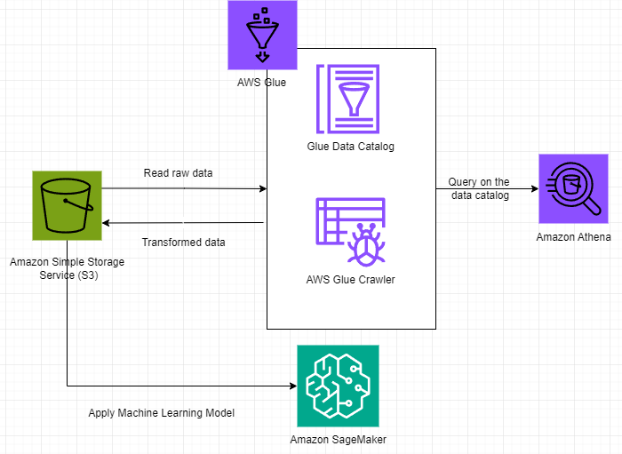
Architecture diagram of the solution
Notes:
Note: Remove this slide from your final presentation.
This example architecture diagram shows a solution to configure a webhook to link Git with AWS. You can find this example in the Toolkits for PowerPoint at https://aws.amazon.com/architecture/icons.

Slide 6
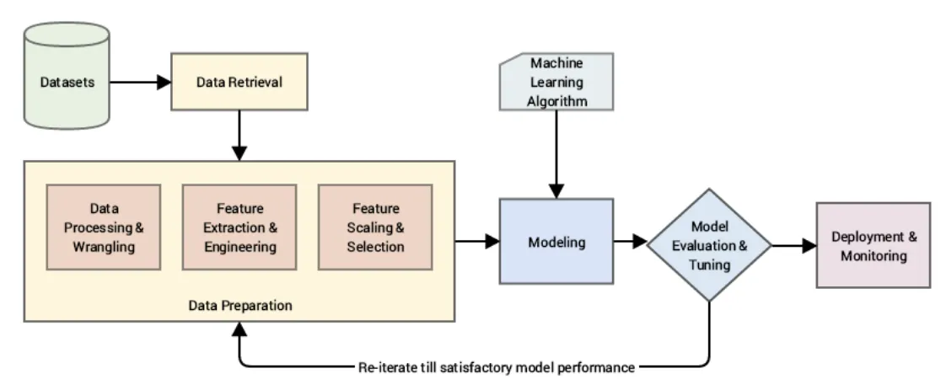
Machine Learning Lifecycle Applied

Slide 7
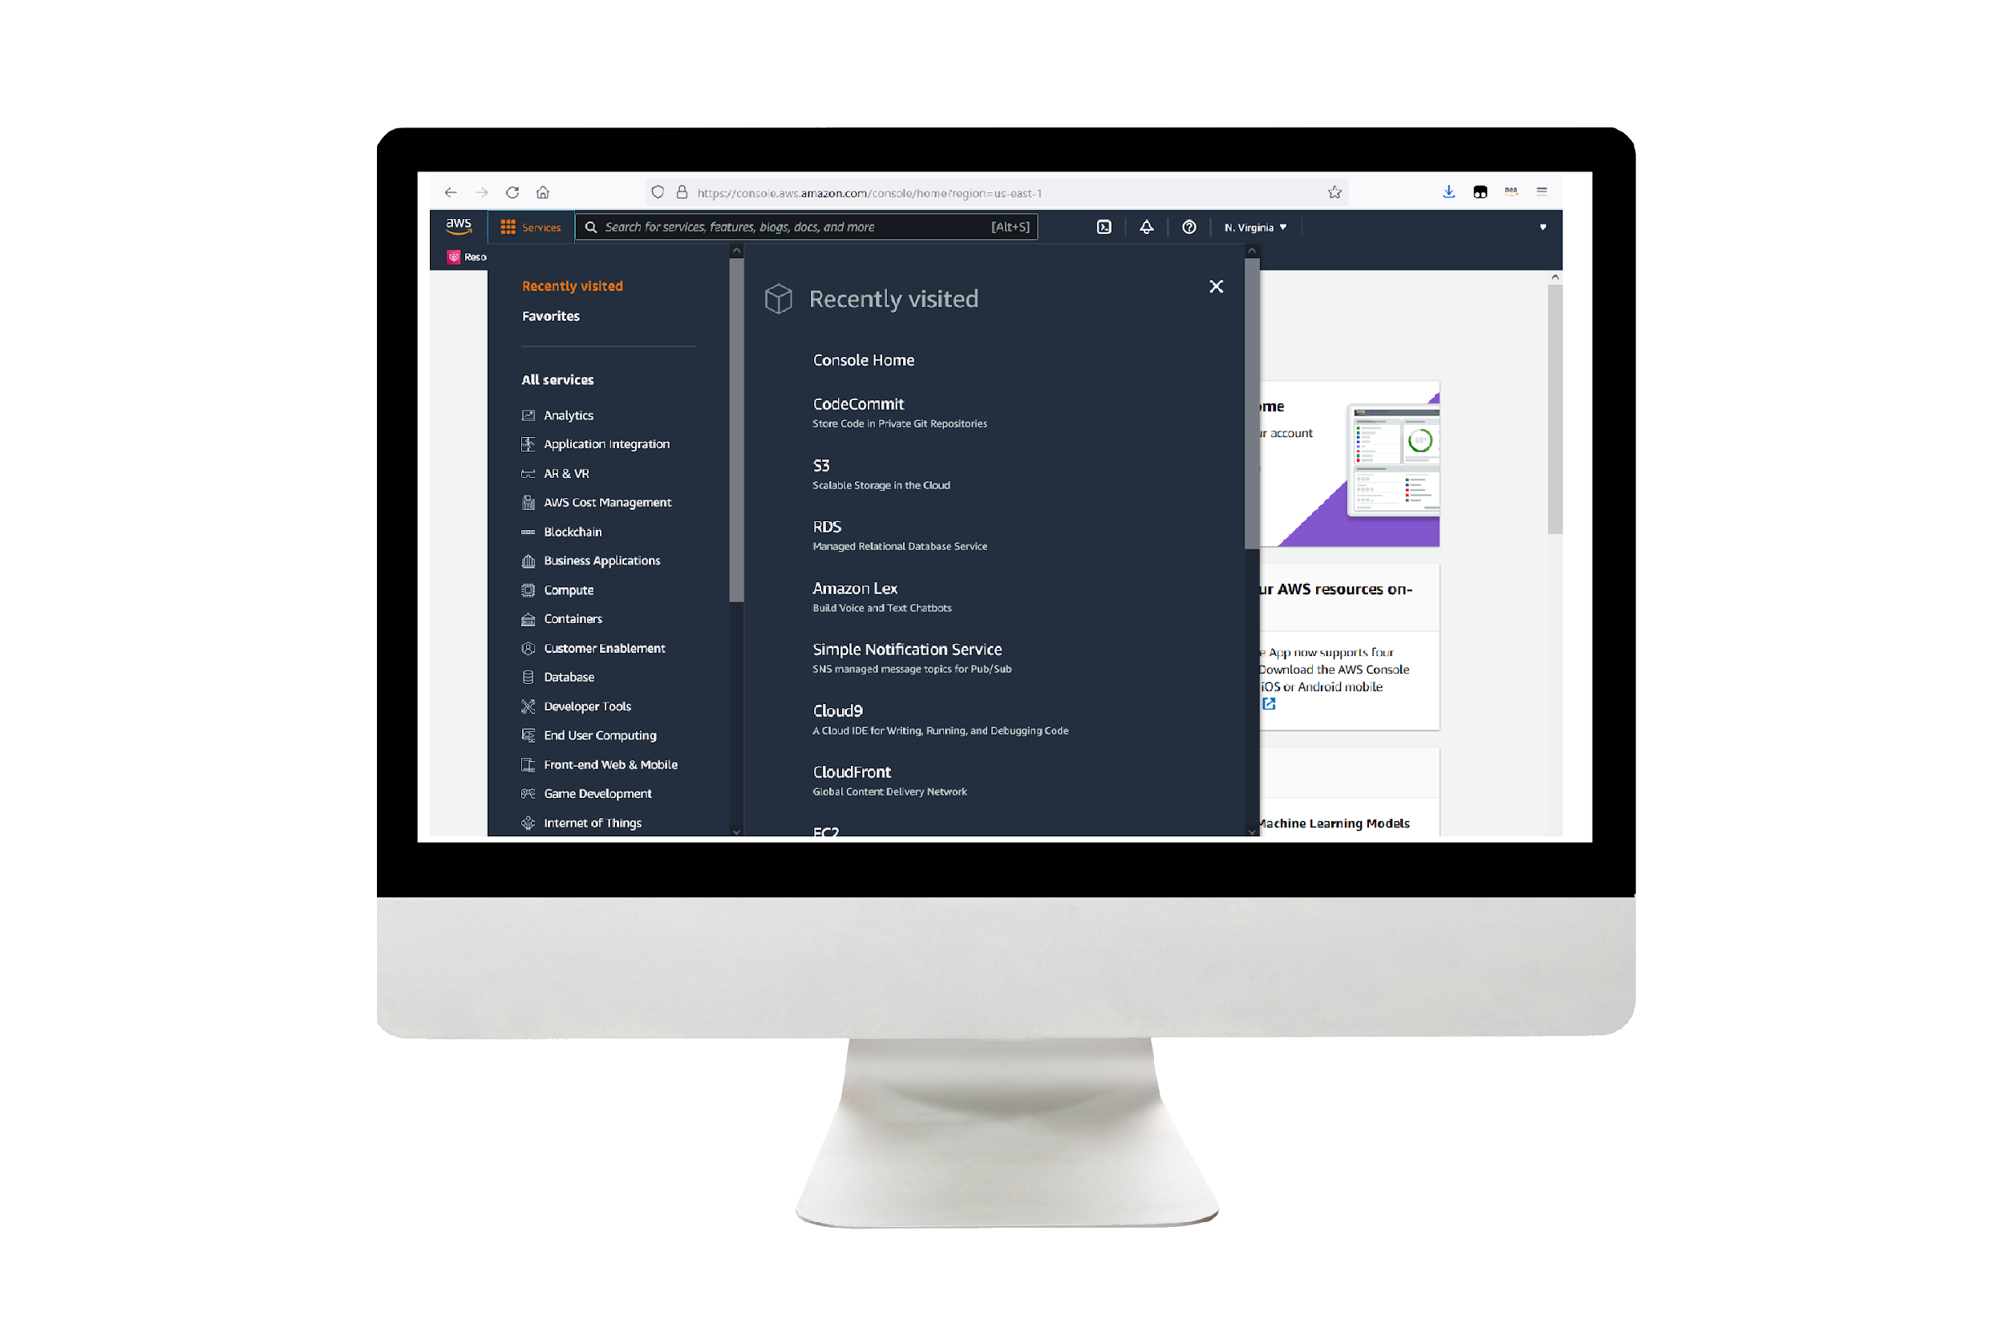
Demo
Project Demonstration following the Machine Learning Lifecycle
Notes:
For the demo, guide the audience through the two to three most important benefits of the solution and how it addresses the requirements.
Your demo materials can be screen captures, recordings, a link to your final solution, and/or a link to AWS console.

Slide 8
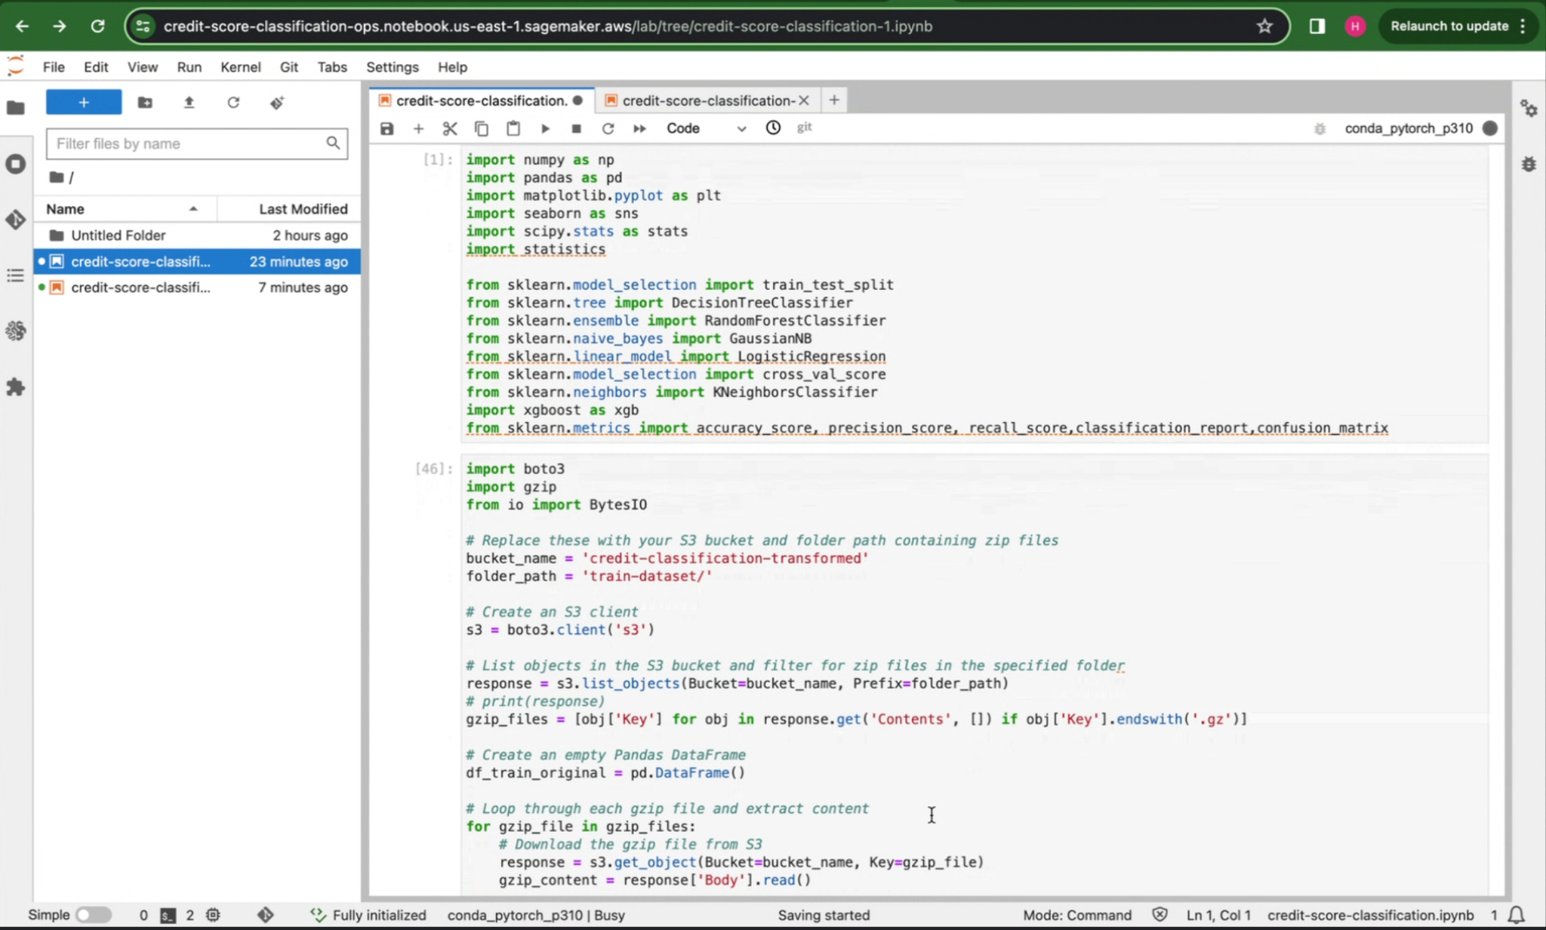
Demo
Data Retrieval
Notes:
Describe any challenges that you encountered and how you overcame those challenges.
For example: “I got stuck when I was creating an EC2 instance to host the application. I used the resources that were listed in the instructions to walk myself through the process to create a new EC2, and I was able to complete the task. The links to labs in other courses were very helpful.”
Describe any new skills that you learned from this project.
For example: “I learned how to set up auto scaling correctly so my resources were automatically adjusted and allocated at the lowest possible cost.”
Discuss any future, out-of-scope use cases in the next steps.
For example: “I would like to scale out the web application so that multiple departments can use it.”

Slide 9
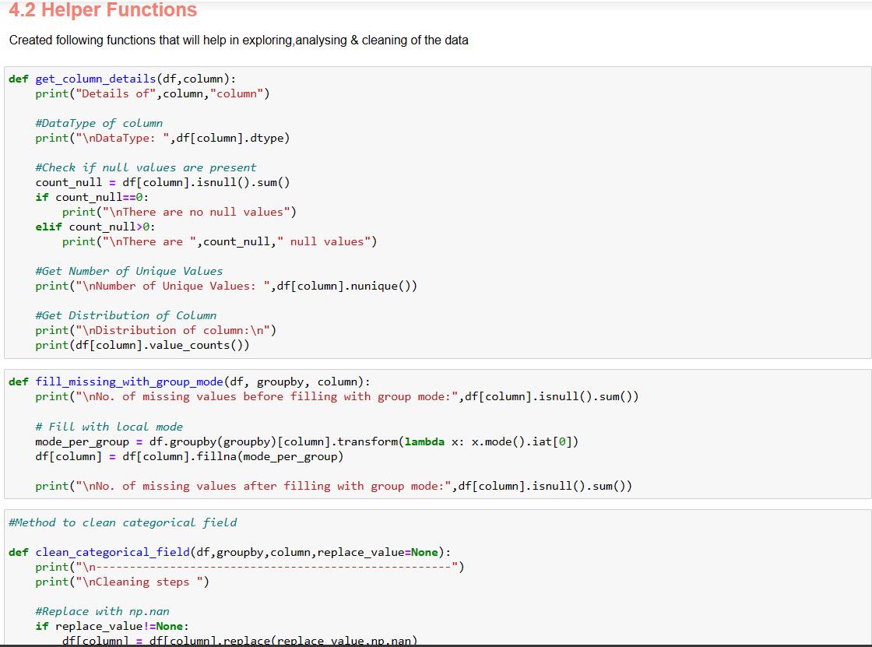
Demo
Data Preprocessing
Notes:
Describe any challenges that you encountered and how you overcame those challenges.
For example: “I got stuck when I was creating an EC2 instance to host the application. I used the resources that were listed in the instructions to walk myself through the process to create a new EC2, and I was able to complete the task. The links to labs in other courses were very helpful.”
Describe any new skills that you learned from this project.
For example: “I learned how to set up auto scaling correctly so my resources were automatically adjusted and allocated at the lowest possible cost.”
Discuss any future, out-of-scope use cases in the next steps.
For example: “I would like to scale out the web application so that multiple departments can use it.”

Slide 10
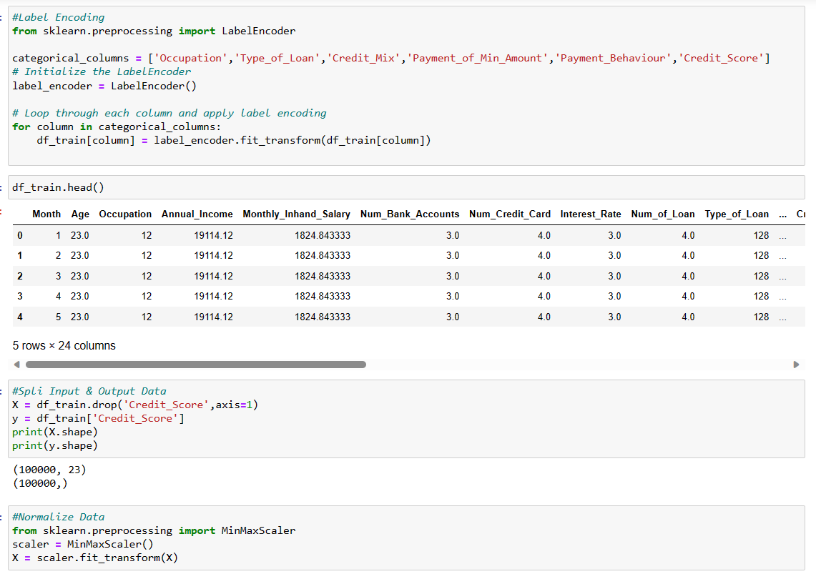
Demo
Data Transformation
Notes:
Describe any challenges that you encountered and how you overcame those challenges.
For example: “I got stuck when I was creating an EC2 instance to host the application. I used the resources that were listed in the instructions to walk myself through the process to create a new EC2, and I was able to complete the task. The links to labs in other courses were very helpful.”
Describe any new skills that you learned from this project.
For example: “I learned how to set up auto scaling correctly so my resources were automatically adjusted and allocated at the lowest possible cost.”
Discuss any future, out-of-scope use cases in the next steps.
For example: “I would like to scale out the web application so that multiple departments can use it.”

Slide 11
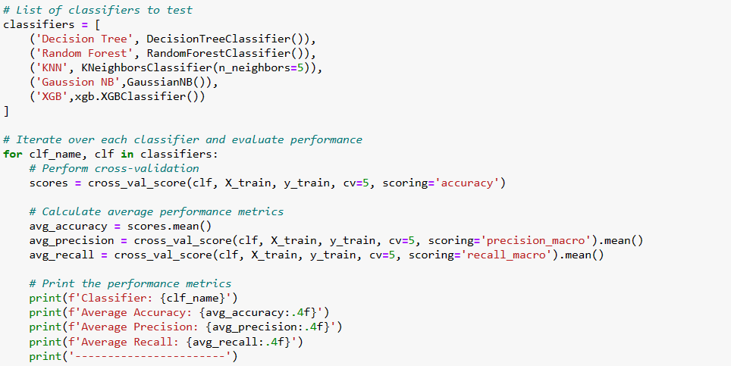
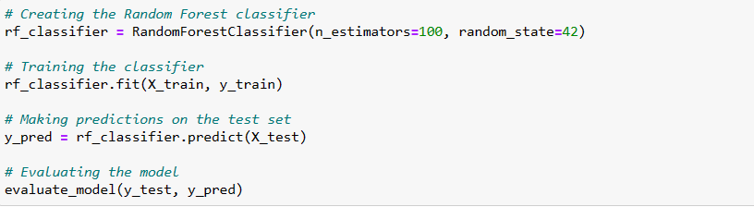
Demo
Modeling and
Evaluation
Notes:
Describe any challenges that you encountered and how you overcame those challenges.
For example: “I got stuck when I was creating an EC2 instance to host the application. I used the resources that were listed in the instructions to walk myself through the process to create a new EC2, and I was able to complete the task. The links to labs in other courses were very helpful.”
Describe any new skills that you learned from this project.
For example: “I learned how to set up auto scaling correctly so my resources were automatically adjusted and allocated at the lowest possible cost.”
Discuss any future, out-of-scope use cases in the next steps.
For example: “I would like to scale out the web application so that multiple departments can use it.”

Slide 12
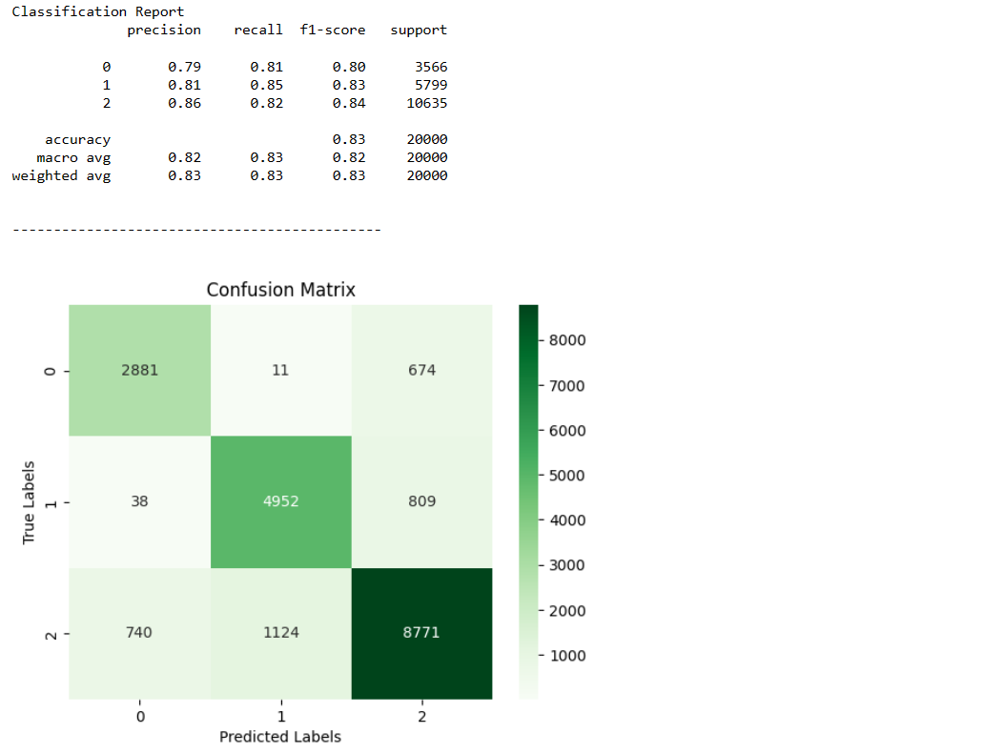
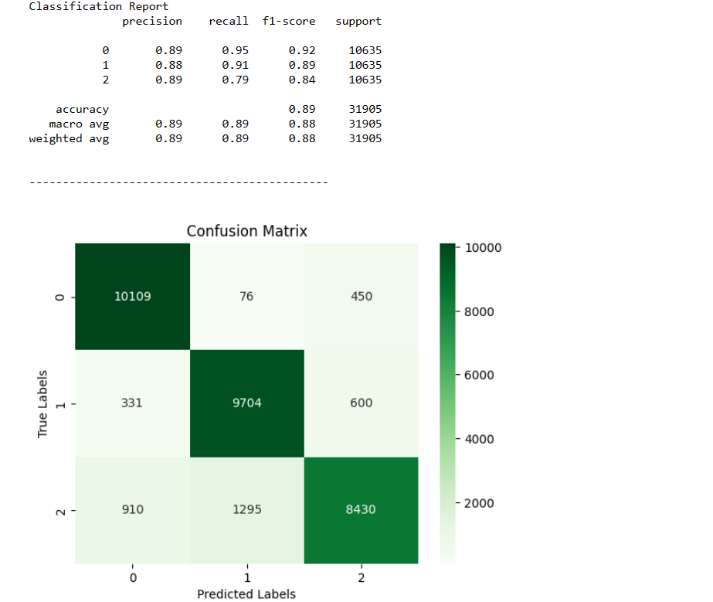
Demo- Results
Approach 1 Approach 2
Notes:
Describe any challenges that you encountered and how you overcame those challenges.
For example: “I got stuck when I was creating an EC2 instance to host the application. I used the resources that were listed in the instructions to walk myself through the process to create a new EC2, and I was able to complete the task. The links to labs in other courses were very helpful.”
Describe any new skills that you learned from this project.
For example: “I learned how to set up auto scaling correctly so my resources were automatically adjusted and allocated at the lowest possible cost.”
Discuss any future, out-of-scope use cases in the next steps.
For example: “I would like to scale out the web application so that multiple departments can use it.”

Slide 13
Lessons learned
Initially, the model execution time on SageMaker was excessively long. We identified that the instance we used in SageMaker had a lower configuration. Once we updated it, the issue was resolved.
We faced issues while cleaning the data, as there were numerous missing and erroneous values. To gain a better understanding of how to handle missing data, we referred to AWS SageMaker examples and tutorials.
We have learned about various model evaluation metrics, such as precision, recall, F1-Score, and AUC. We also gained insights into AWS Cost Explorer and identified possible cost for each service that we have used.
We have developed the model for predicting the credit score. As a next step, we will develop a GUI where businesses can enter the financial details of the user and determine the creditworthiness of the person.
Notes:
Describe any challenges that you encountered and how you overcame those challenges.
For example: “I got stuck when I was creating an EC2 instance to host the application. I used the resources that were listed in the instructions to walk myself through the process to create a new EC2, and I was able to complete the task. The links to labs in other courses were very helpful.”
Describe any new skills that you learned from this project.
For example: “I learned how to set up auto scaling correctly so my resources were automatically adjusted and allocated at the lowest possible cost.”
Discuss any future, out-of-scope use cases in the next steps.
For example: “I would like to scale out the web application so that multiple departments can use it.”

Slide 14
Thank you

